Slide 1
Indexes Explained
B*Tree and Bitmap indexes

Slide 2
Indexes have 3 main uses:
To quickly find specific rows by avoiding a Full Table Scan
To avoid a table access altogether
If the information is in the index, then Oracle doesn't bother to read the table.
To avoid a sort
Oracle performs a sort for many reasons: ORDER BY, GROUP BY, DISTINCT, ,UNION, etc.
If a sort requires rows in the same order as the index, then Oracle may read the rows via the index, and avoid accessing the table.

Slide 3
Indexes are…
Created automatically for Primary key and Unique constraint columns
Recommended to create an index on a foreign key column as well
Default type: B*tree

Slide 4
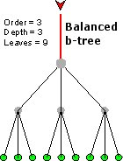
Balanced tree (B*tree)

Slide 5
B*Tree Index
Use only on high cardinality columns
(like last names, there are a lot of different last names)
And there are a large number of rows in the table
And generally queries retrieve no more than 2% - 4% of the rows

Slide 6
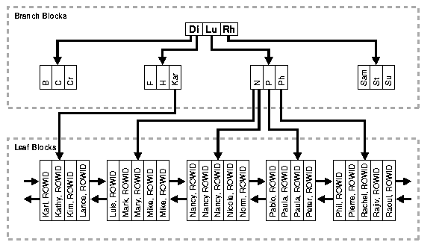
B*Tree on FirstName Looking for ‘Peter’

Slide 7
Bitmap Indexes
only use on low cardinality columns (like True/False or Male/Female)
use them mostly in data warehouses
do not use them on tables with heavy updates

Slide 8
Bitmap example: Vehicle table
VID | Type | Color
1 | car | Blue
2 | car | Red
3 | truck | White
4 | car | Blue
5 | truck | red
6 | car | red
Type:
CAR 1 1 0 1 0 1 …
TRUCK 0 0 1 0 1 0 …
Color:
BLUE 1 0 0 1 0 0 …
WHITE 0 0 1 0 0 0 …
RED 0 1 0 0 1 1 …

Slide 9
SELECT * FROM Vehicle WHERE type = ‘truck’ AND color = ‘white’
TRUCK 0 0 1 0 1 0 …
Use Boolean AND
WHITE 0 0 1 0 0 0 …
BOTH: 0 0 1 0 0 0 …
The only white truck is in the third row of the table.

